Slide 1

STUDENTS: DROUZAS VASILIS MONIAKI MELINA STATHOPOULOS DIMITRIS TRADALIDIS GIANNIS
Athens University of Economy and Business
Master of Science in “Data Science”
Data Visualization and Communication
“Analyzing Bicycle Usage Data from Washington Capital Bikeshare”

Slide 2

Aim of the study:
Explore bicycle usage data from the Washington Capital Bikeshare system
Analyze data from January to April of the years 2020, 2021, 2022, and 2023
On April 2, Governor Inslee announced that the stay at home order would be extended through at least May 4.
Approach:
Explore the dataset to:
Analyze usage patterns across different time periods
Determine the most commonly used bike types and member subscription types
Identify the stations and routes that are most frequently used
Evaluate the profitability of the top stations and bike types.

Slide 3
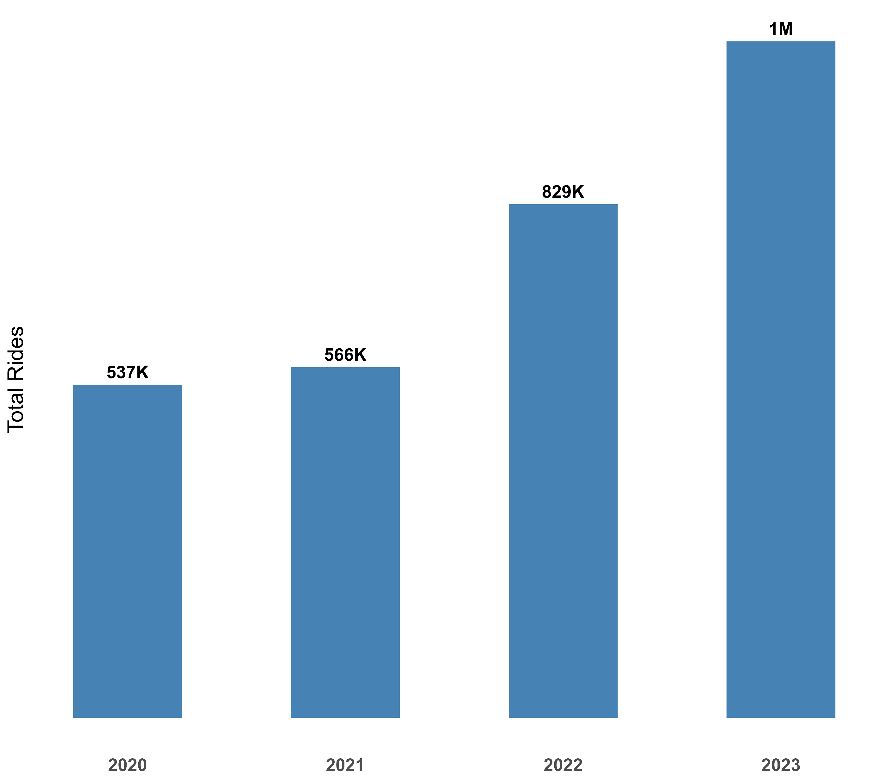
Total Rides by Year
Growing trend in bike usage over the years

Slide 4
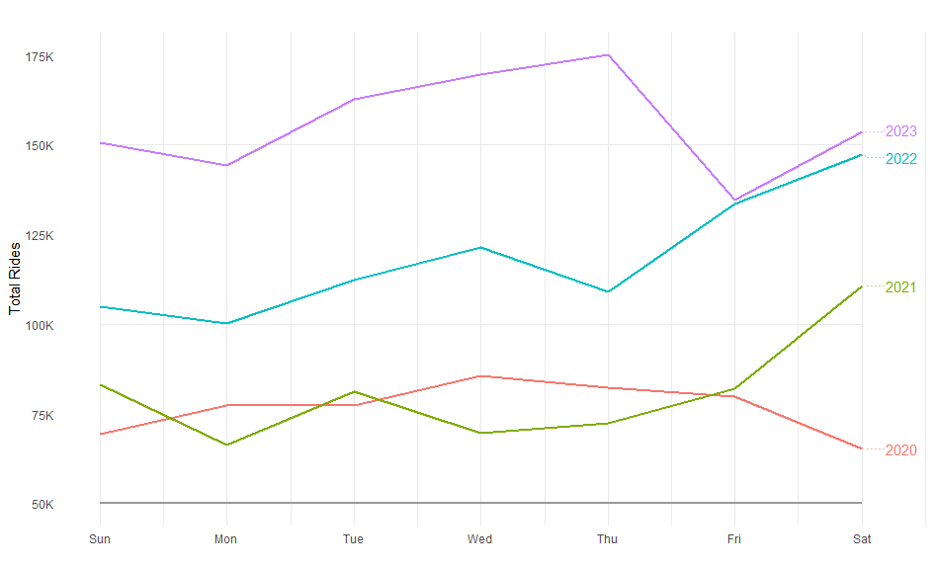
Total Rides by Day of Week

Slide 5
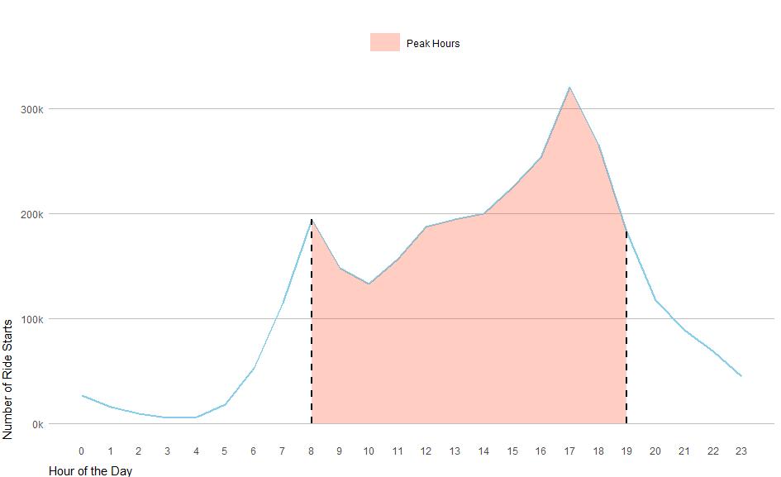
Ride Start Time Distribution

Slide 6
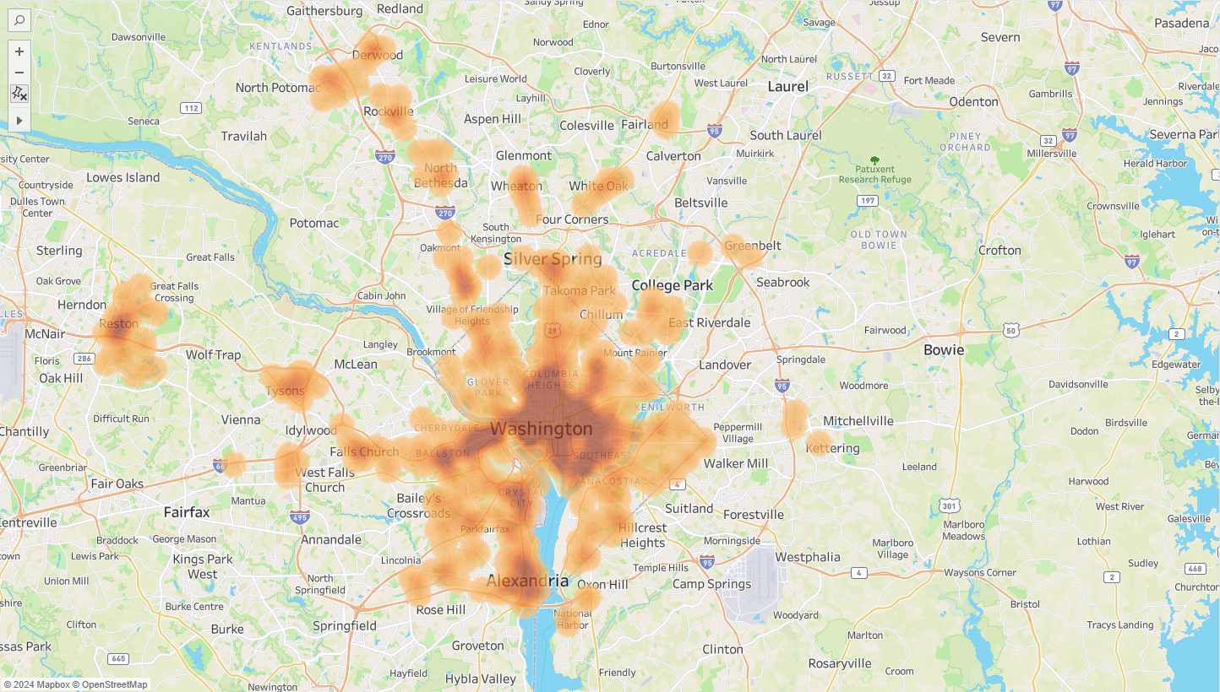

Slide 7

Membership Analysis

Slide 8
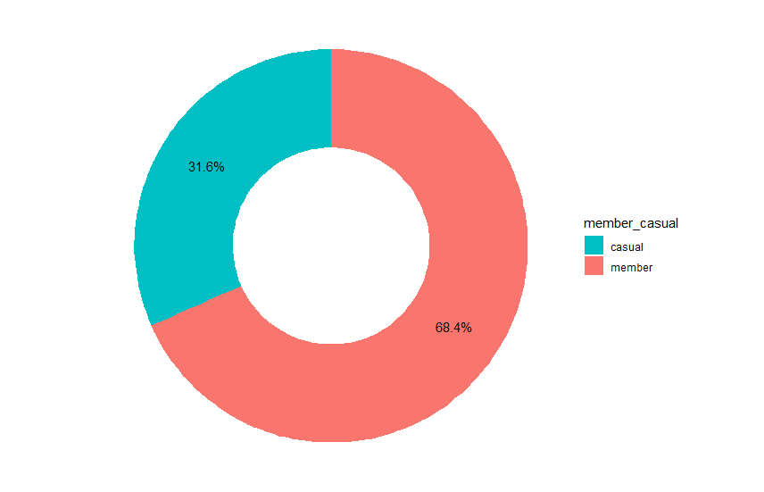
Membership Ratio

Slide 9
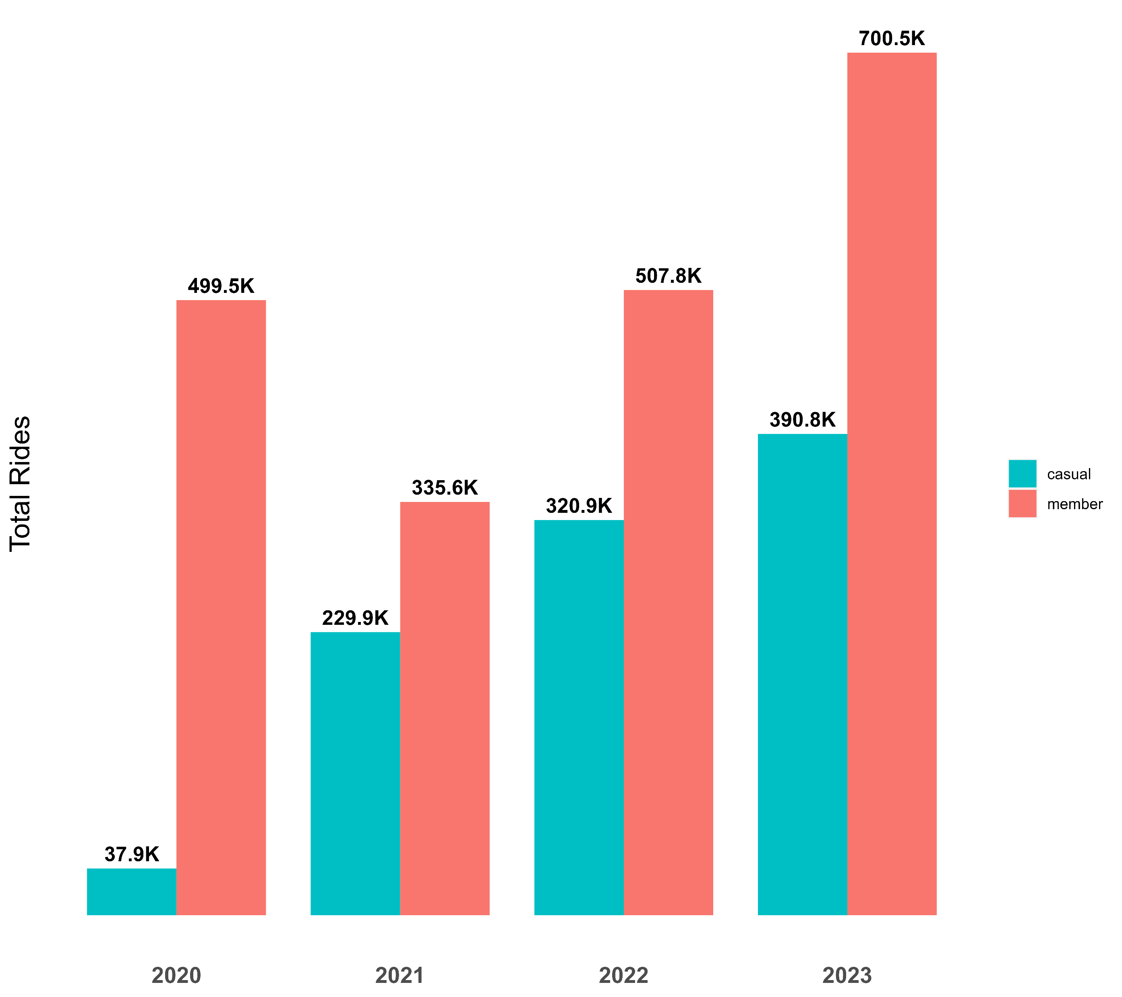
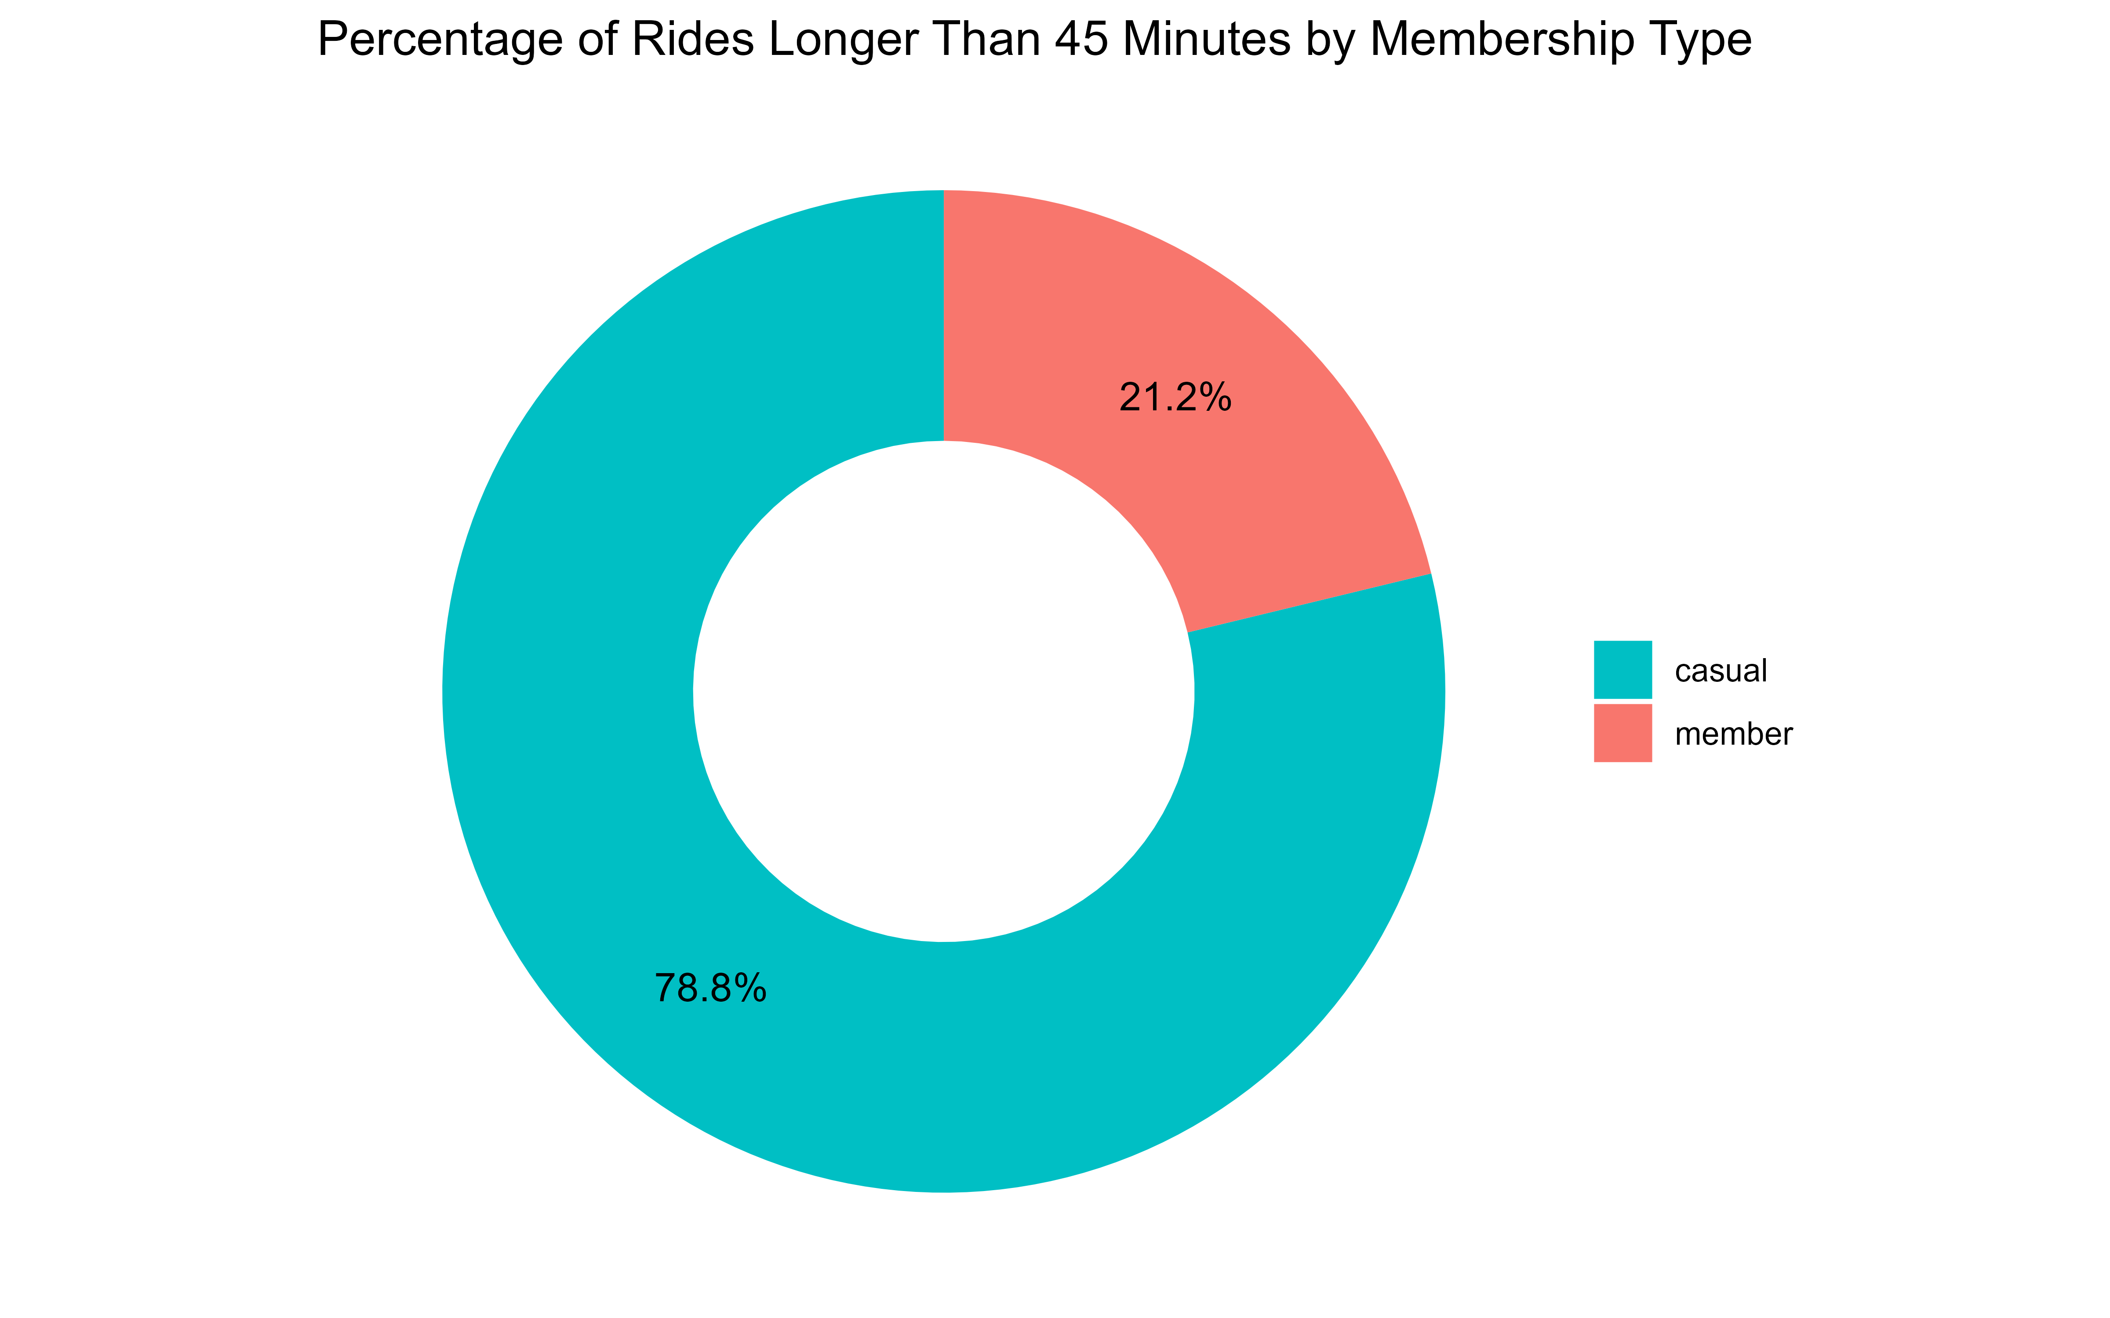
Total Rides by year and member type

Slide 10
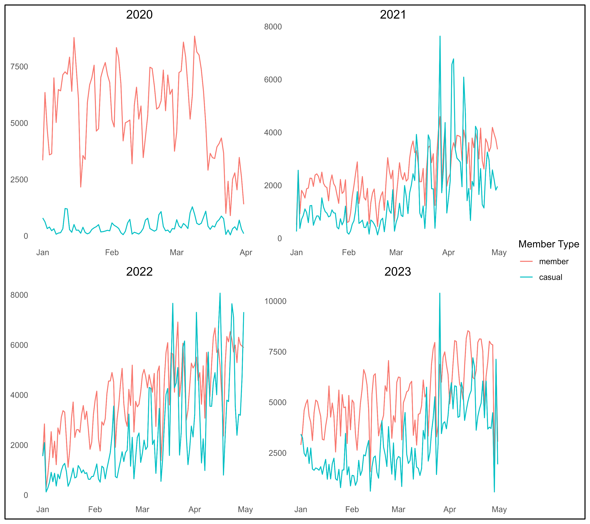
Monthly Total Rides By Year

Slide 11
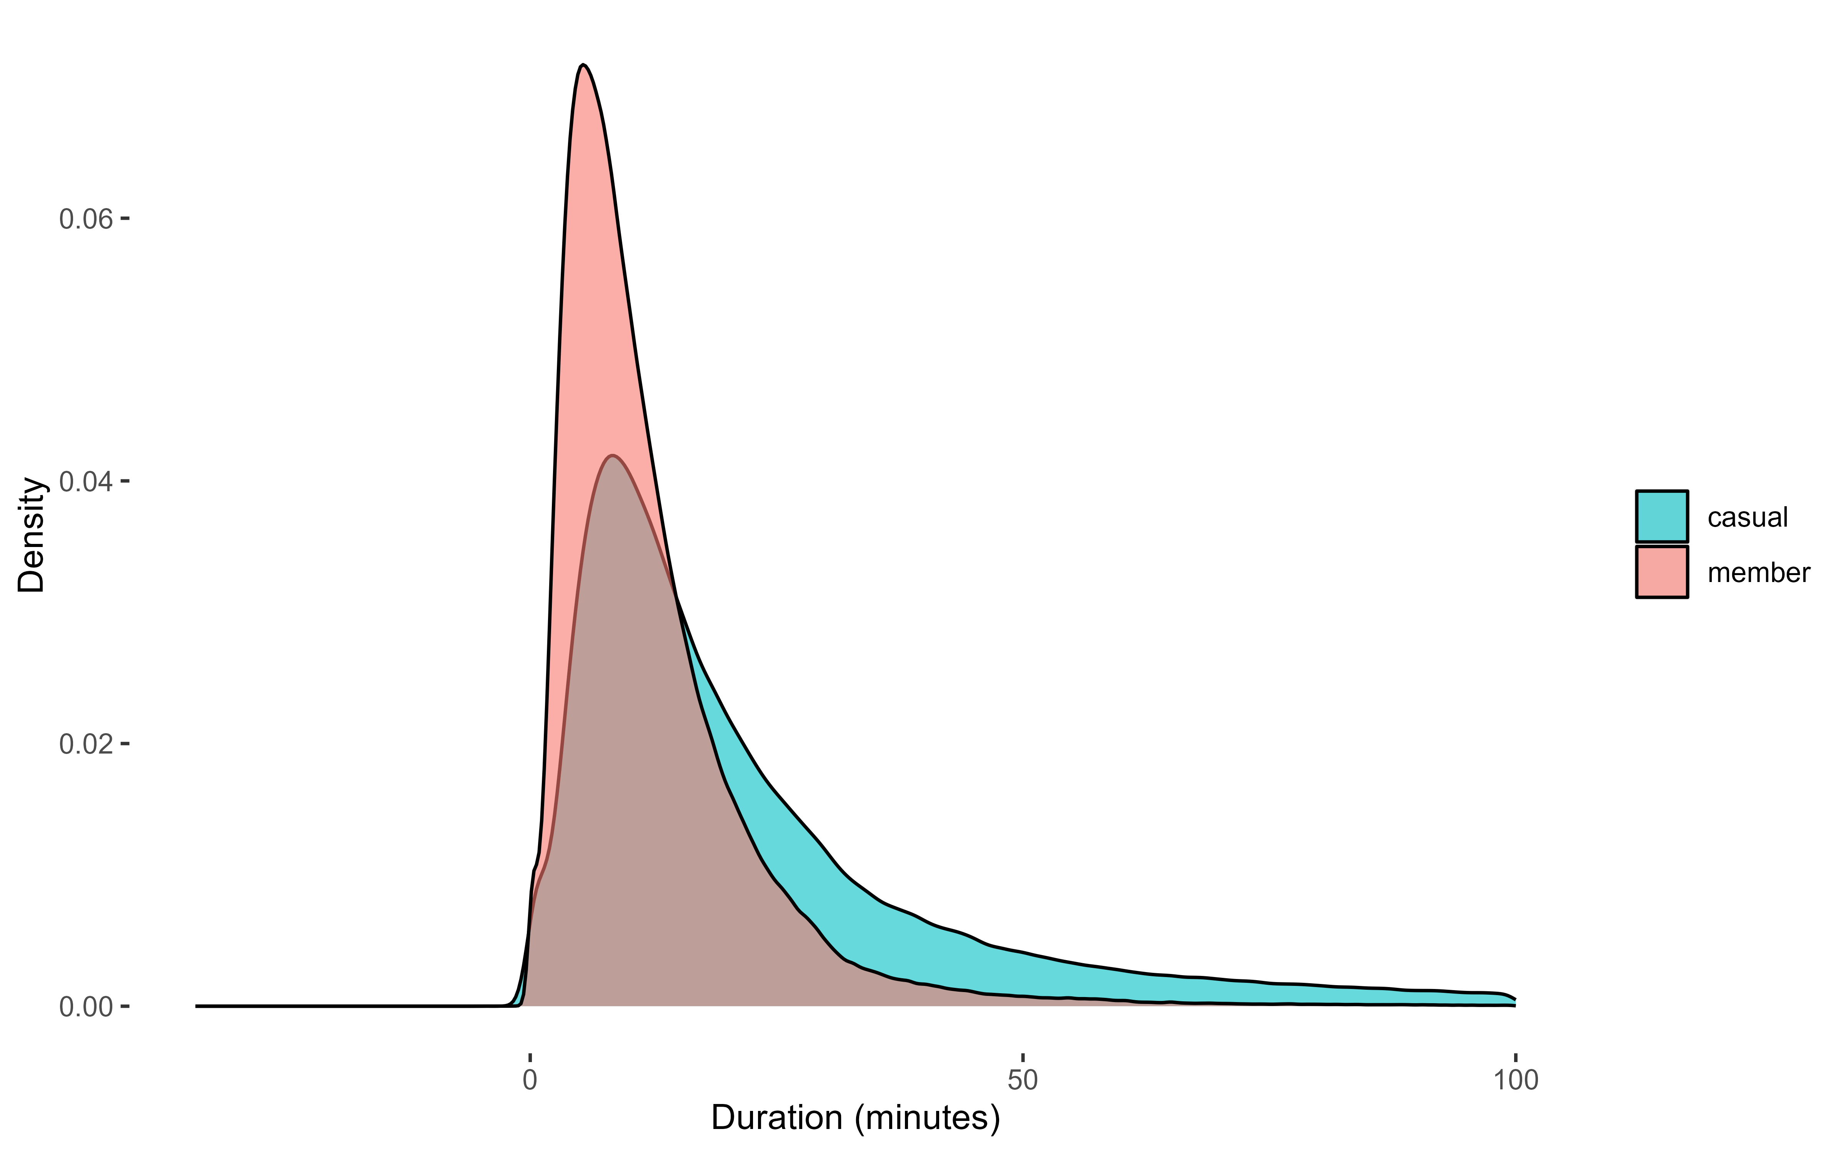
Distribution of Ride Duration by Membership Type

Slide 12
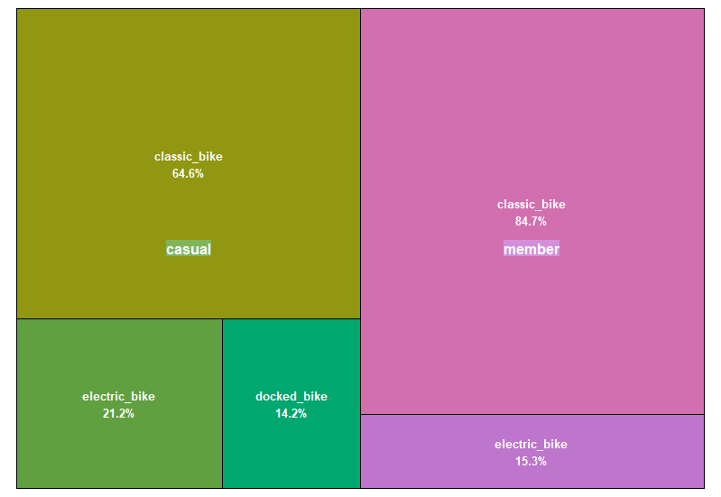
Bike Usage Percentage by Member Type and Bike Type

Slide 13

Bike Type and Station Revenue

Slide 14
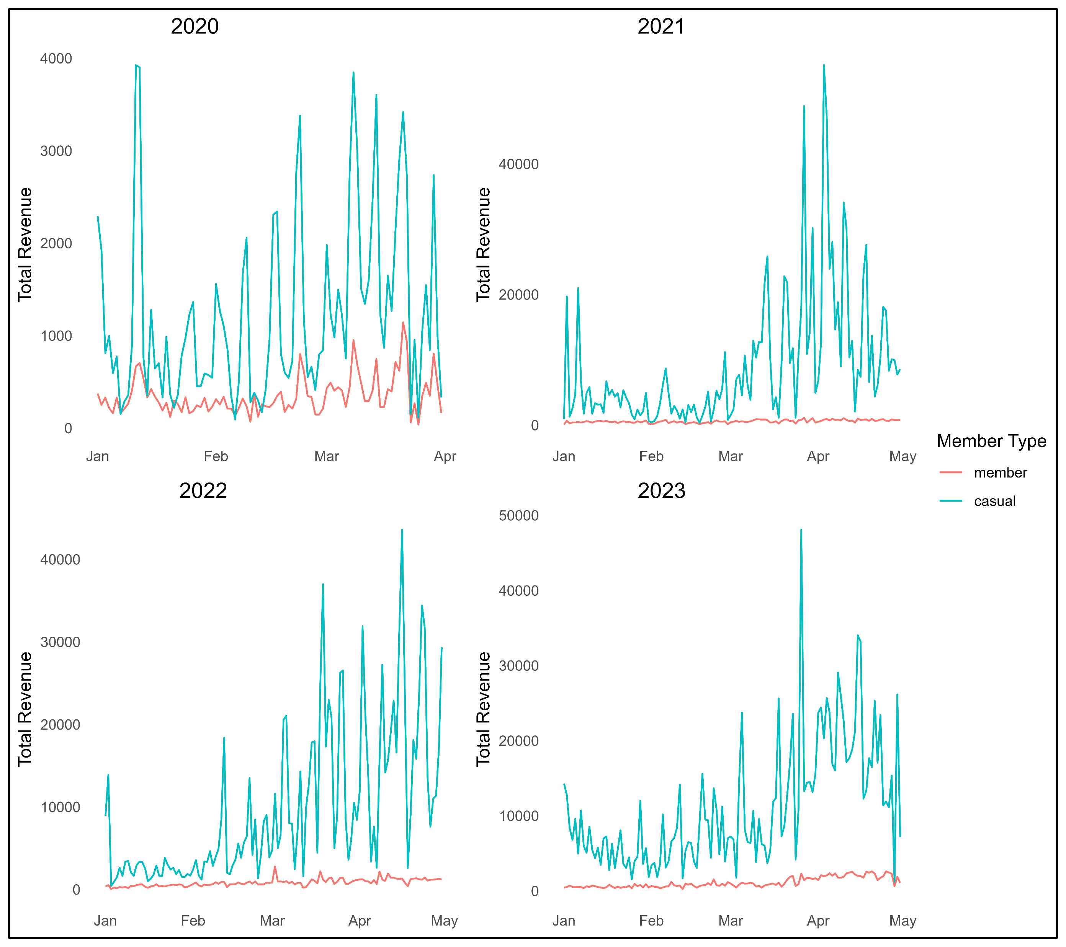
Yearly total profit per membership type

Slide 15
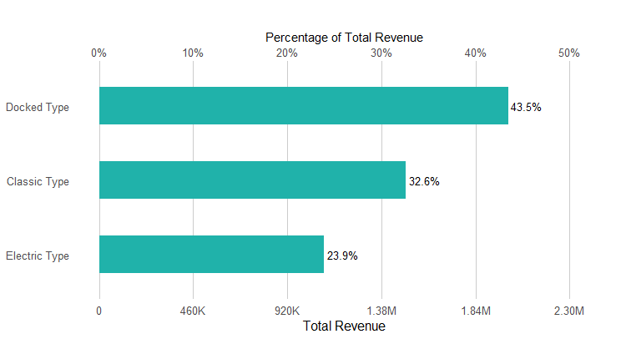
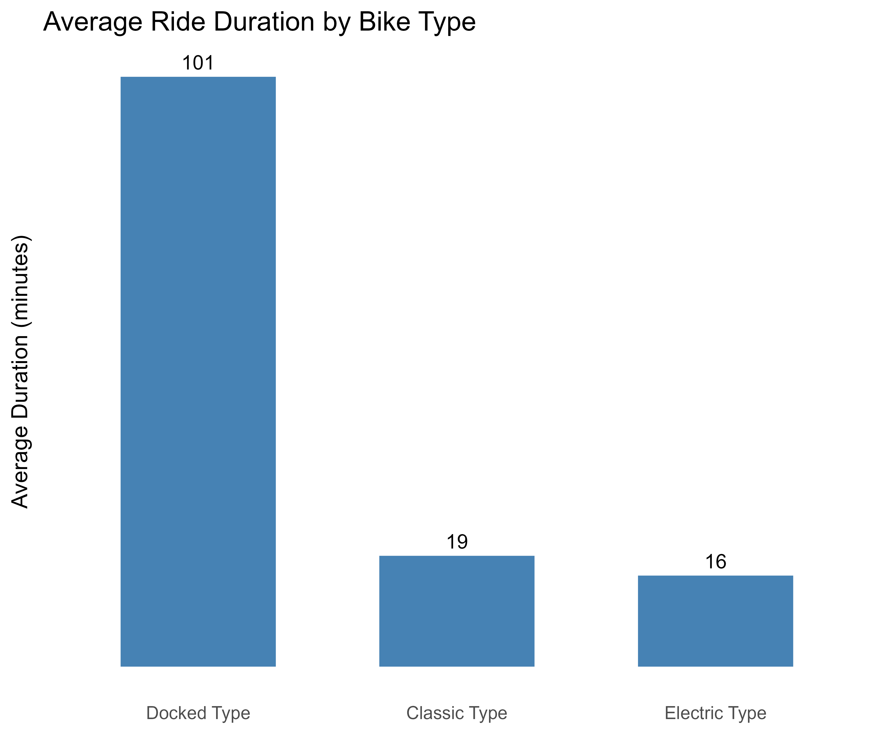
Total Revenue by Bike Type

Slide 16
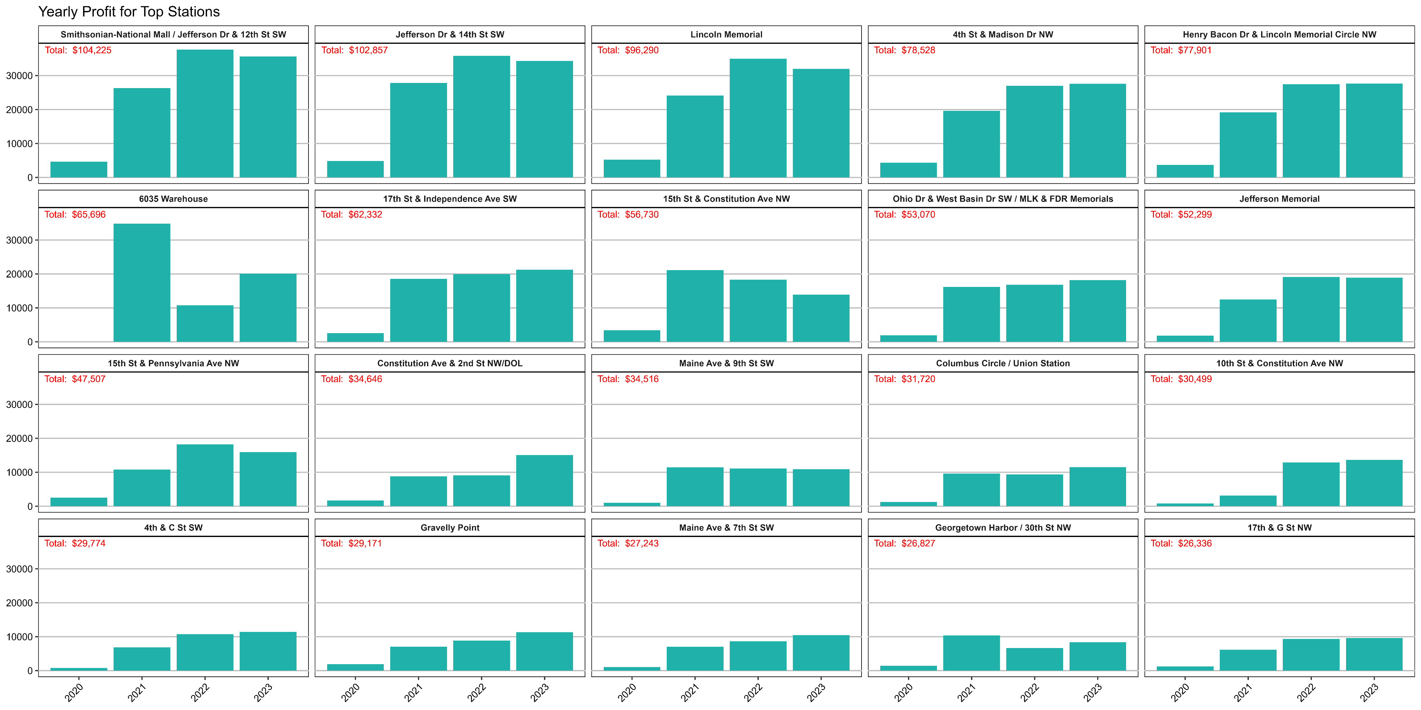
Total Profit over time for top Stations

Slide 17
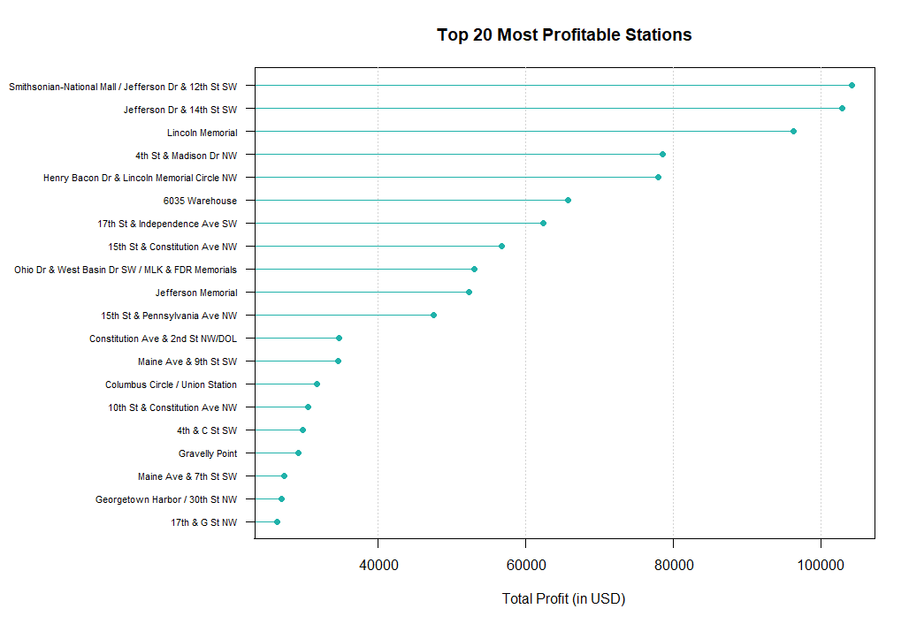
Most Profitable Stations over the years

Slide 18
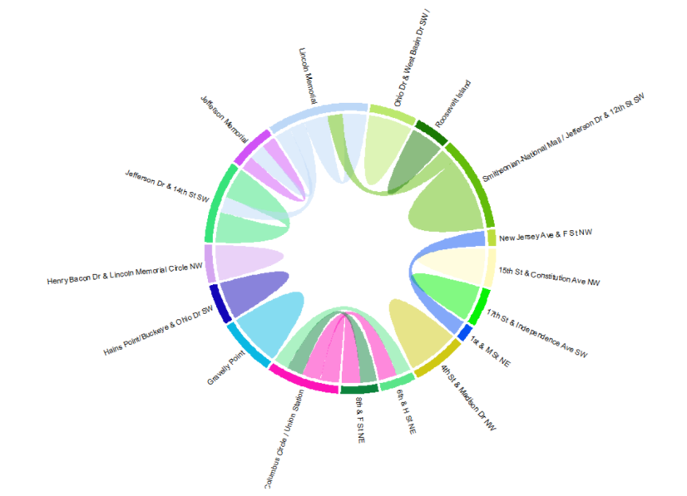
Top 20 Most Common Bike Routes

Slide 19
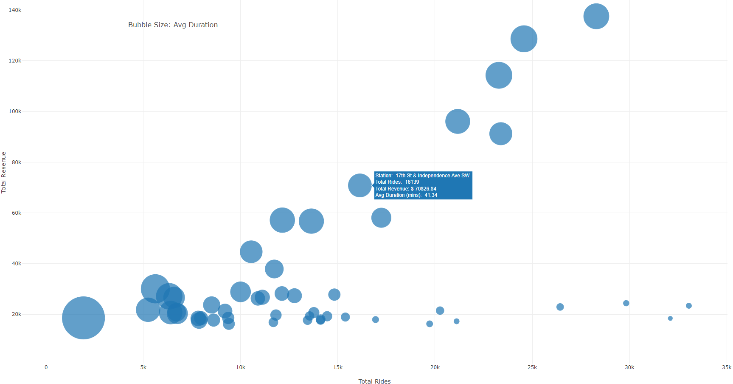
Most Profitable Station By Rides and Revenue

Slide 20

Tableau Interactive Plots Following

Slide 21
Conclusions
Yearly growing trend in bike ride and usage.
Concentrated amounts for ride starts around Washington Alexandria etc.
Peak Usage 8:00a.m. to 19:00p.m.
Member subscription offers a 45-minute free ride period, which could influence members to favor shorter rides or attract riders who anticipate taking primarily shorter trips.
From 2021 to 2023, both member and casual rider groups exhibited an upward trend in total rides from January to April, potentially due to improving weather conditions during the spring months.
Even though the docked bike is rarely used, it brings the greatest profit to the company, because its users do lengthy rides.
The most profitable stations are the most central ones.
2020, with the pandemic and the quarantine measures, diminished the use of bicycles & the company’s profit.
The most common bike routes are concentrated around stations near the capital, indicating high activity in these areas.

